Slide 1
Associative Rule Mining And Classification System in the Cloud
Jafet Morales

Slide 2
The Problem
To develop a method for classifying instances depending on categorical values
Where can this be used?
Example: classify restaurants based on categorical descriptions given by people, such as:
Food:good
Location:bad
Price:high
Service:horrible
Data for this example
In this example categorical data was generated artificially from a dummy dataset

Slide 3
The Data
The raw data was generated by examining seed kernels with X-ray techniques and measuring the following properties
Area
Perimeter
Compactness=4*pi*A/P^2
Length
Width
Asymmetry coefficient
Length of kernel groove
All of the values above were preprocessed to generate the categorical data

Slide 4
Preprocessing
The categorical data was generated by splitting each attribute into four groups
These four groups are the four quartiles of the distribution for each attribute

Slide 5
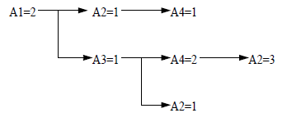
Associative Rule Mining
In order to perform classification, an associative rule-based technique was used
Rules that associate each category to a type of seed are first mined and then these rules are used to classify the seeds
There is no single rule that can classify everything correctly
Also, we must use the smallest number of rules to avoid overfitting the classifier to the training data

Slide 6
The Foil Algorithm
A positive example: an instance that belongs to the class in question
A negative example: an instance that does not belong to the class in question
The FOIL algorithm is used to find rules that can help distinguish negative from positive examples for a single class
The algorithm is run for each class we want to be able to classify

Slide 7
Input: Training set D = P [ N. (P and N are the sets of all positive and negative examples, respectively.)
Output: A set of rules for predicting class labels for examples
The rules are found based on Foil Gain:

Slide 8
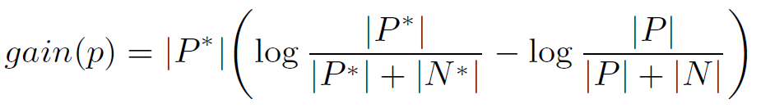
Generating A Single Rule
A single rule is generated by creating a boolean operation of concatenated ANDs, such as the following:
Example rule for finding a good restaurant: (food==good)AND(location==good)AND(price==low)AND(service==good)
In order to generate the rule you must choose which features and which categories you want in the rule
This is done based on Foil Gain
If there is no gain by adding (restrooms==clean) to the rule, meaning we do not care about the restrooms in the restaurant, then this literal is not added to the rule
A threshold is put on the gain

Slide 9
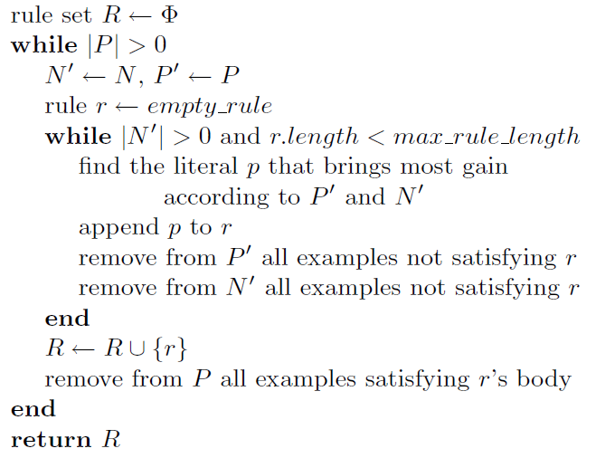
Pseudocode

Slide 10
Algorithm is more complex than it looks
Finds rules to classify all negative examples in the inner loop
Finds rules to classify all positive examples in the outer loop

Slide 11
Implementation
I used matrices in Python instead of IF statements
The representation I used is shown next

Slide 12
Rule Representation By Matrices
I represented a rule with three matrices
Matrix 1: contains the features used for each rule
Matrix 2: contains the values that the instance is supposed to have for each one of those features in order to comply by the rule and is same size as Matrix 1
Matrix 3: contains the class to which the rule belongs

Slide 13
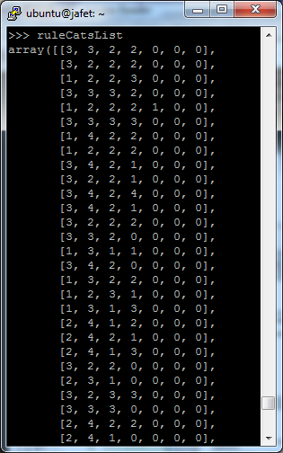

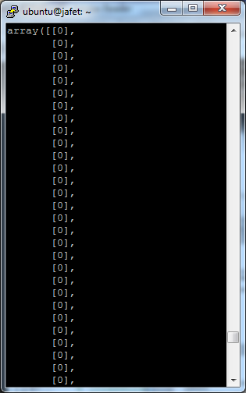
Rule Representation By Matrices

Slide 14
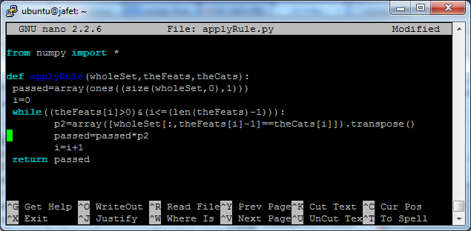
Classification Stage
Each rule is checked for compliance in the entire dataset
This generates a matrix
Height=number of instances being classified
Width=number of rules being used

Slide 15
From this matrix, two more matrices are generated with the same size
First matrix: holds the classes to which each complied rule belongs
Second matrix: holds the confidence for each complied rule
Confidence=support/(total instances that passed the rule test)
Support=total instances that were true positives to the rule
The confidence for each class is then averaged for each instance and the class with the maximum average confidence is chosen

Slide 16

Accuracy
After classifying each instance, accuracy can be calculated as follows:
(#correctly classified instances)/(# of instances)
An accuracy of 88.1% was obtained

Slide 17
Conclusion
I was able to use the cloud to implement an Associative Rule Mining and classifying system with a good accuracy.
An extension would be to find a way to select the top rules to reduce the classification workload

